Slide 1
Ms Jesslyn
Digital HR Assistant
Cabin Crew Digital Recruitment
TEAM NOT BAD SIA

Slide 2

Recruitment Event

Slide 3
THE PROBLEM
Recruitment Event
Round 1: Group Interview
Resources spent (time, money)
1
Step

Slide 4
THE PROBLEM
Recruitment Event
Round 2: Skin & Weight Check
Resources spent (time, money)
1
2
Step

Slide 5
THE PROBLEM
Recruitment Event
Round 3: Individual Interview
Resources spent (time, money)
1
2
3
Step

Slide 6
THE PROBLEM
Recruitment Event
Round 4: Management Interview
Resources spent (time, money)
1
2
3
4
Step

Slide 7
THE PROBLEM
Recruitment Event
Round 5: Kebaya Check
Resources spent (time, money)
1
2
3
4
5
Step

Slide 8
THE PROBLEM
Recruitment Event
Round 6: Health Checkup
Resources spent (time, money)
Disproportionate spending of resources!
1
2
3
4
5
6
Step

Slide 9
THE PROBLEM
5%
8%
Yield:

Slide 10
THE PROBLEM
Too much effort,
too little yield.

Slide 11
Here’s what you get:
A super-intelligent interview assistant to make your next hire a success.

Slide 12
Meet Ms Jesslyn
Digital HR Assistant

Slide 14
OUR SOLUTION
Virtual Interview
Smart Assistant
Lesser Effort, Greater Yield
Allow candidates to interview with Skype anytime, anywhere to increase number of applications.
Use Artificial Intelligence to shortlist top candidates from talent pool for further screening.
Maximise your resources by evaluating only high-potential candidates.

Slide 15
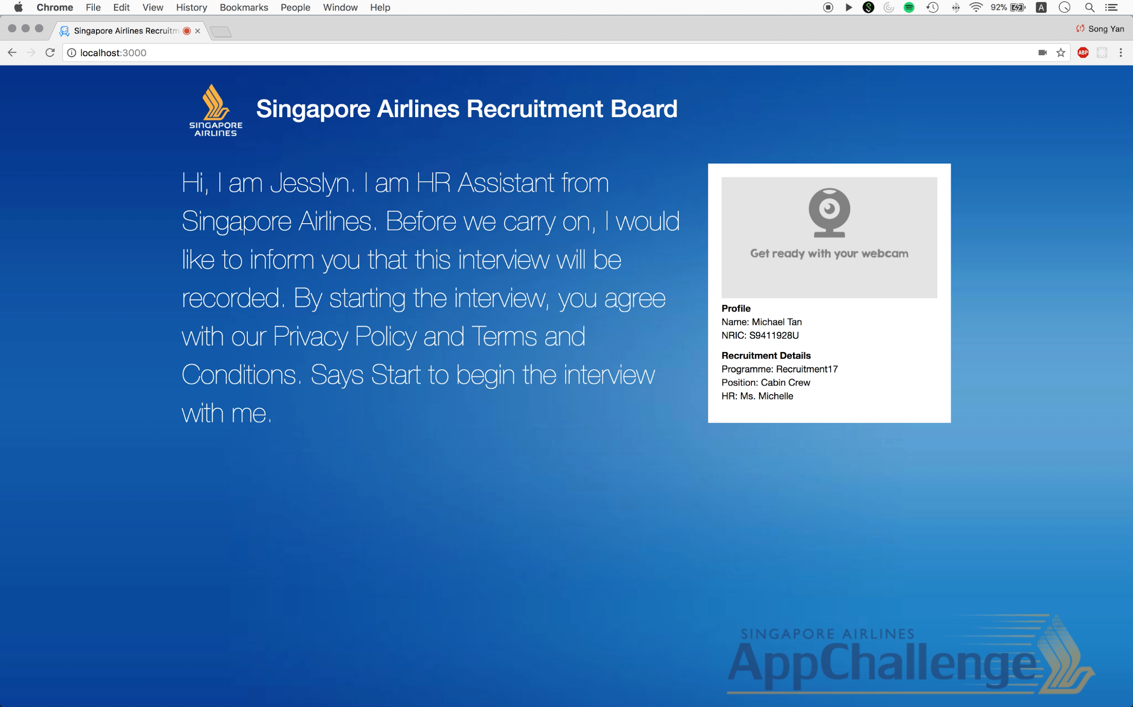
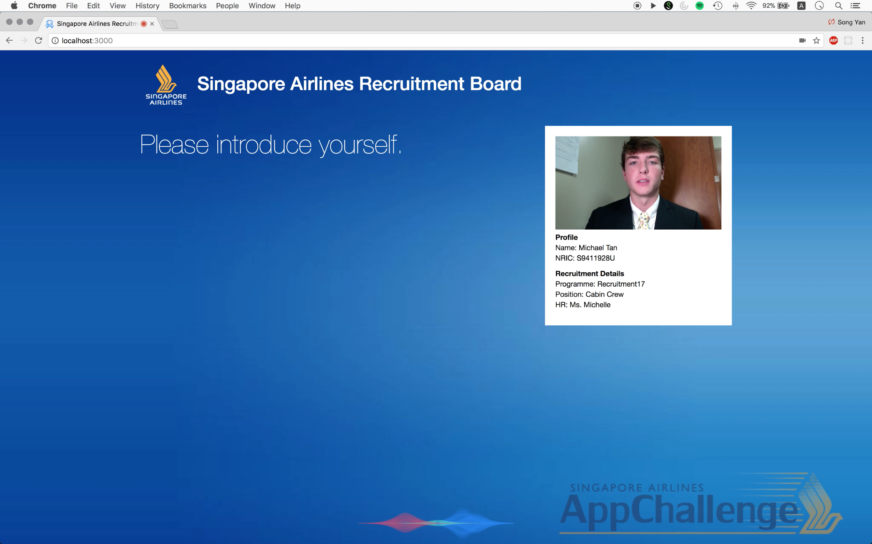
Recruitment Flow
1
Candidates engage Ms Jesslyn to initiate the interview and the process is recorded

Slide 16

Recruitment Flow
Reinvent Recruitment Flow
2
Jesslyn cut recorded interview into multiple parts for video analysis

Slide 17

Recruitment Flow
3
Analyse candidate performance with AI technology
Tone
Sentiment
Proficiency
Emotion
Messages
Sincerity

Slide 18




Recruitment Flow
3
Analyse candidate performance with AI technology

Slide 19


Recruitment Flow
4
Pick the best candidates from the talent pool that meet the requirements
Kimberley Lee Xiao Xin
Language proficiency
Score
9.7
51th/2784
Positivity
Work experience
Interview performance

Slide 20

Recruitment Flow
4
Pick the best candidates from the talent pool that meet the requirements

Slide 21
WHAT THIS MEANS FOR SIA
Saves HR Executives and top management a great deal of time
Number of interviewees every year: 3000
Total time spent in interviewing one person: 30 minutes
Time saved: 1500 employee hours!

Slide 22
WHAT THIS MEANS FOR SIA
Saves HR Executives and top management a great deal of time
Number of interviewees every year: 3000
Total time spent in interviewing one person: 30 minutes
Time saved: 1500 employee hours!
All recruitment processes
Pilots
Engineers
Ground Professionals

Slide 23
WHAT THIS MEANS FOR SIA
Collation of useful suggestions and feedback through interview recordings
Scalability and Convenience
Efficient and high tech process provides a better experience for interviewees

Slide 24
FUTURE ENHANCEMENTS
Add a human touch and conversational feel to the interview process using NLP
Real time analysis of interviewee’s answers

Slide 25
Thank you!

